Slide 1
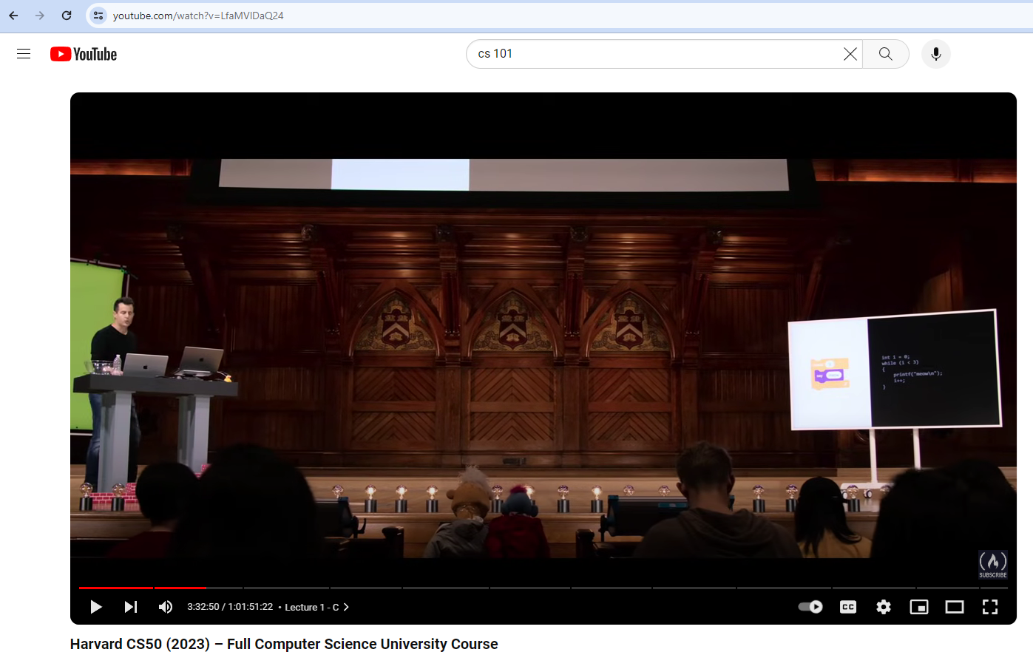
YouTube video to text summery for educational centers and Project research
By: Dev Chakraborty

Slide 2
Why this topic ?
Have noticed the ads and length of the content has increased. It would save a lot of time if by using Natural Language Processing. To make short summery in text from the YouTube link given.

Slide 3
Project details
The models used in the journey:
Natural Language Toolkit: It helps convert text into numbers, which the model can then easily work with
Gensim is designed to handle large text collections using data streaming and incremental online algorithms

Slide 4
Project details
The models used in the journey:
spaCy is a free, open-source Python library that provides advanced capabilities to conduct natural language processing (NLP) on large volumes of text at high speed.
en_core_web_sm: A small English pipeline trained on written web text.
tensorflow : helps you implement best practices for data automation, model tracking and performance monitoring

Slide 5
Project details
The models used in the journey:
torchvision: TorchVision is a library within PyTorch for image and video processing, it contains a number of important and useful data sets, model architecture.
pytube: For downloading YouTube videos.
Sentence-transformers measuring semantic similarity between sentences or text passages.

Slide 6
Project details
The models used in the journey:
Ncluster : I used for Clustering-based Summary.
TF-IDF is short for “Term Frequency-Inverse Document Frequency”: It helps the computer understand which words matter the most in a text.
youtube_transcript_api to get the transcripts/subtitles for a given YouTube video

Slide 7
Project details
BART stands for “Bidirectional and Auto-Regressive Transformer”.
It can be used for many language tasks like summarizing text, translating languages, sorting sentences, or answering questions.
Used Bart pre-trained tokenizer and Bart pre-trained model for the summarization
For tokenizer /abstraction summarization-
'facebook/h-cnn’2’=Is pre-trained by
(1) corrupting text by it self
(2) learning a model to reconstruct the original text.
Embedded/extractive summarization –
Paraphrase-MiniLM-L6-v2’3=This is a sentence-transformers model: It maps sentences & paragraphs used for tasks like clustering.

Slide 8
Project details
K-means clustering is used to group similar data points together in a process known as clustering.
google-cloud-speech: speech to text transcription from audio files in over 80 languages.
The transformer models Transformers provides thousands of pretrained models to perform tasks on different modalities such as text, vision, and audio.

Slide 9
The summery is a different way
Abstractive summary: Uses natural language techniques to interpret and understand the important aspects of a text and generate a more “human” friendly summary.
Clustering-based Summary: It works by organizing items into groups – or clusters – based on how closely associated they are.
Extractive summarization: Picking the most relevant sentences from an article and systematically organizing them.

Slide 10
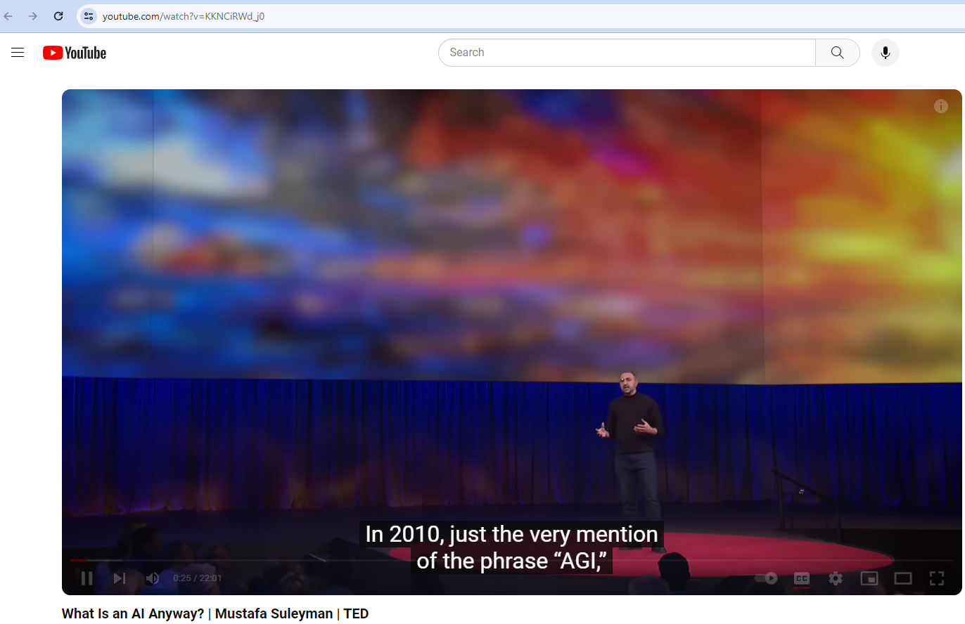
Let’s test it out now

Slide 11
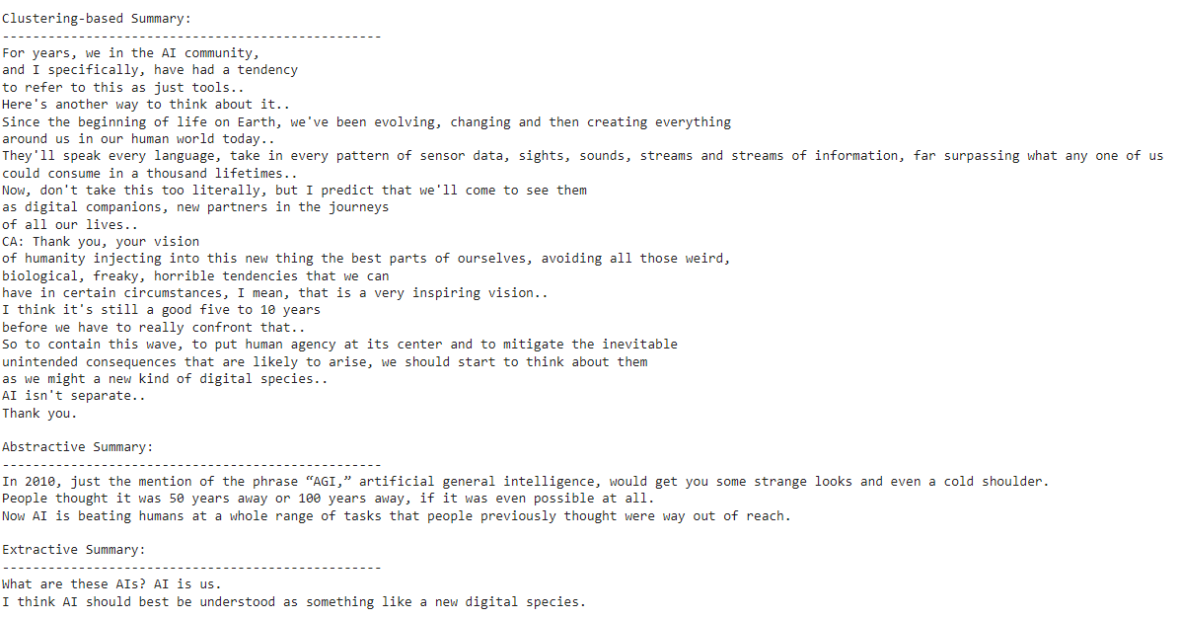
Summery of the Ted talk

Slide 12
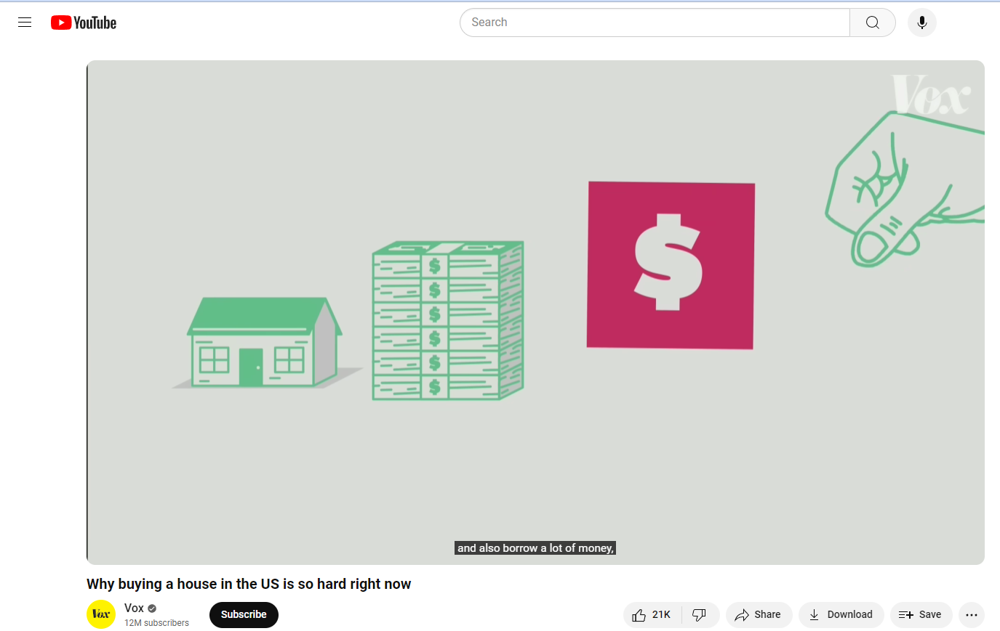
Do you want buy a house here

Slide 13
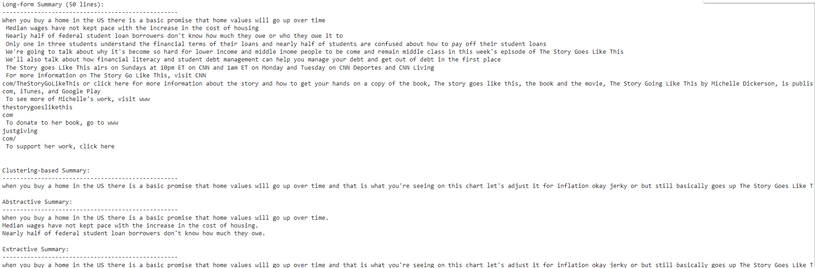
Do you think house is possible in this lifetime?

Slide 14
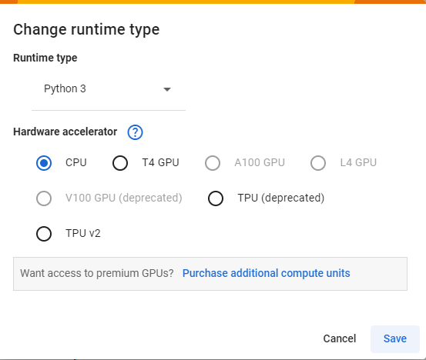
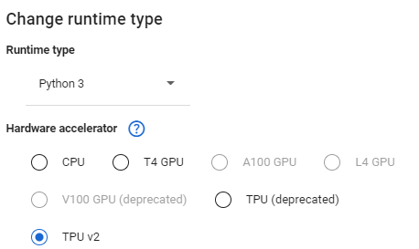
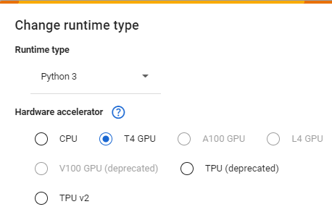
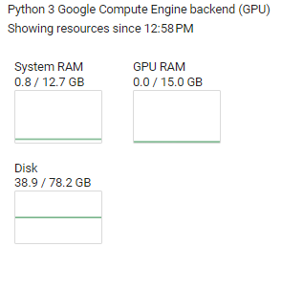
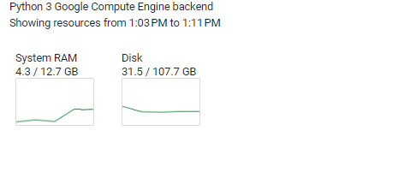
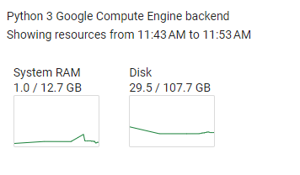
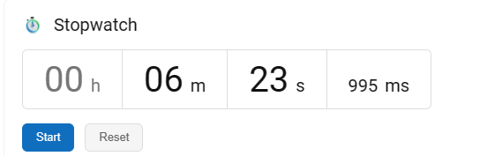
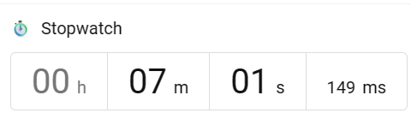
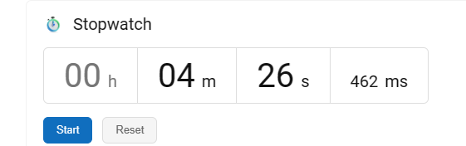
These are different Runtime Environment did the testing
CPU Option Specification
TPU Option Specification:$ needed for full support
GPU Option Specification

Slide 15


